Slide 1
Notes:
Following deposition of the Kaibab, the shoreline regressed yet again, but this time was different. Orogeny was beginning to affect the western margin of North America to the degree that the Grand Canyon region could no longer really be considered a divergent continental margin. Eroding mountain ranges produced a tremendous quantity of clastic sediment which deposited in the region throughout the Mesozoic.

Slide 2
Act 4
“Gone Baby Gone”
MESOZOIC SEDIMENTATION AND EARLY CENOZOIC LARAMIDE UPLIFT
Notes:
Where is all that Mesozoic sediment in the Grand Canyon?

Slide 3
south
north
1 mile
Notes:
Well those pages of the history book have been pretty much completely eroded from the Grand Canyon during the broad uplift of the area which began at the end of the Mesozoic. A great pile of Mesozoic sediment, at least a mile thick, was stripped from the Grand Canyon. These sedimentary rocks still exist to the north of the canyon …

Slide 4
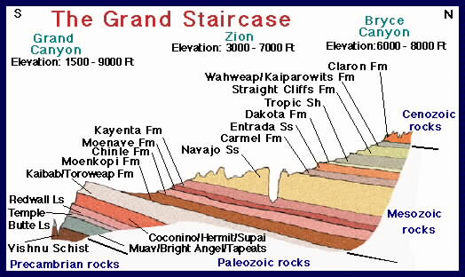
Notes:
… in places like Zion and Bryce Canyon, forming a stepped sequence of younger rocks to the north known as the “Grand Staircase”.

Slide 5
north
south
Notes:
If you have visited these parks, the realization that they are all part of the Grand Staircase comes as a grand epiphany. For many, it is the first realization that there are understandable connections between vastly separated geologic features.

Slide 6
Notes:
If that gave you Goosebumps, you might be a geologist at heart!

Slide 7
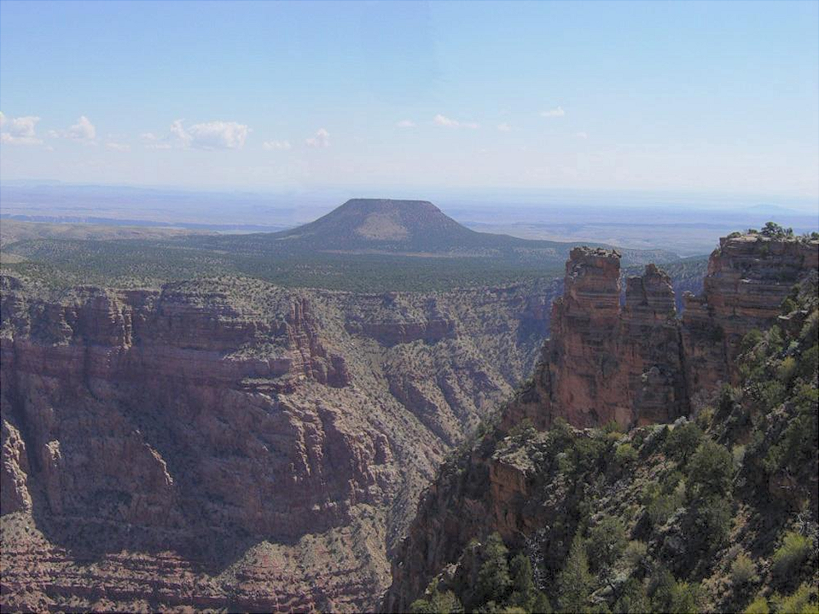
Cedar Mountain – A Mesozoic Remnant
Notes:
Cedar Mountain is one of very few places near the Grand Canyon where erosional remnants of the once thick Mesozoic section still exist.

Slide 8
Notes:
The broad upward arching of the Grand Canyon region was linked to the same compression forces that created the nearby Rocky Mountains. This Early Cenozoic orogeny, known as the Laramide, folded and faulted broad areas of the western states.

Slide 9
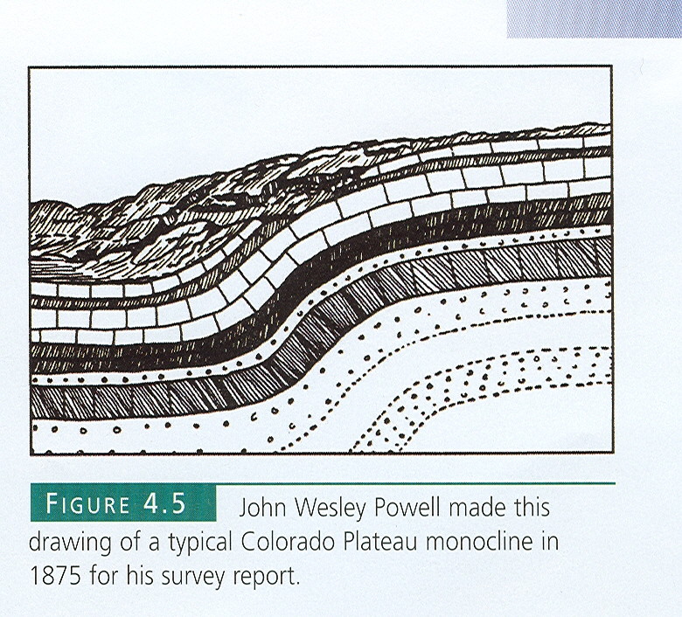
Notes:
In the Grand Canyon region it produced, in several places, unusual folds called monoclines because they only have one sloping side.

Slide 10
Former normal fault becomes reverse fault
Notes:
Monoclines formed in the Grand Canyon area because Precambrian normal faults (remember the Proterozoic rift valleys?) were reactivated by Laramide compression and converted into reverse faults. The somewhat flexible Paleozoic and Mesozoic sedimentary rocks above these faults folded as reverse motion occurred along these faults.

Slide 11
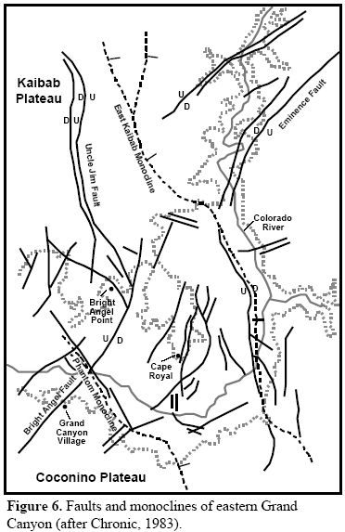
Notes:
One of the most prominent is the East Kaibab Monocline, whose single slope tilts toward the east and has no doubt influenced the course of the Colorado River.

Slide 12
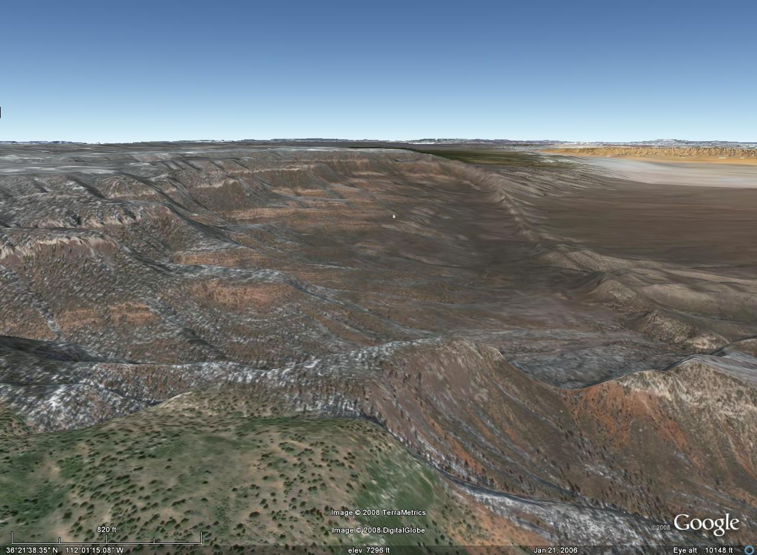
East Kaibab Monocline
Notes:
Looking along the monocline’s axis in this Google Earth view of its northern end you can see where erosion has breached the fold’s surface.

Slide 13
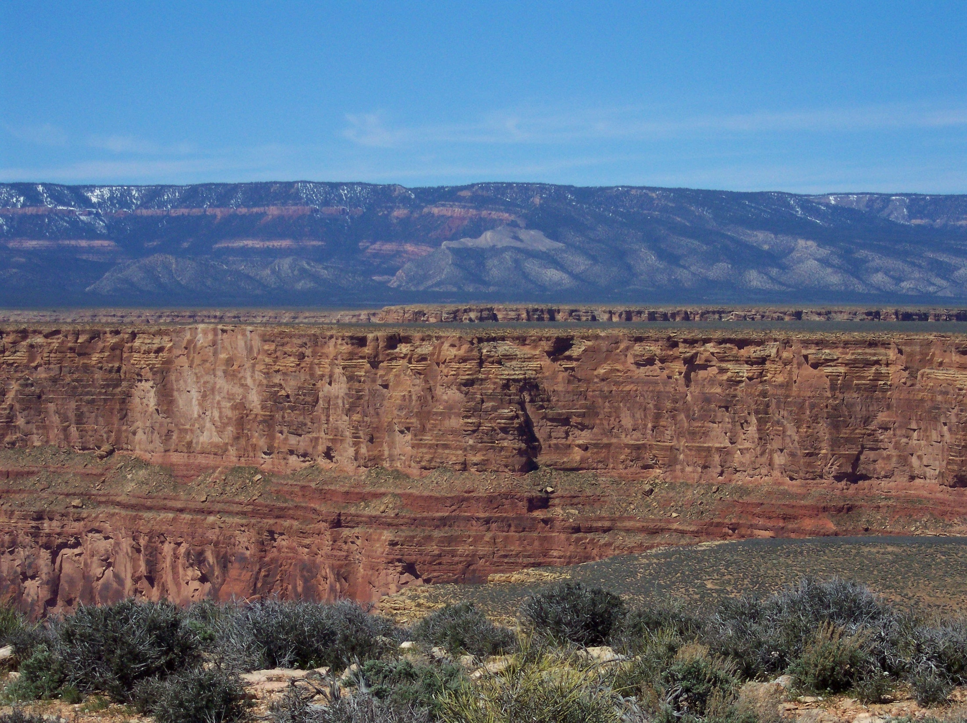
East Kaibab Monocline
WEST
Notes:
Here’s the same monocline from the ground. The single slope is tilted towards the camera.

Slide 14
Act 5
“Colorado Plateau Iceberg”
LATE CENOZOIC UPLIFT
Notes:
And now for the final act.

Slide 15
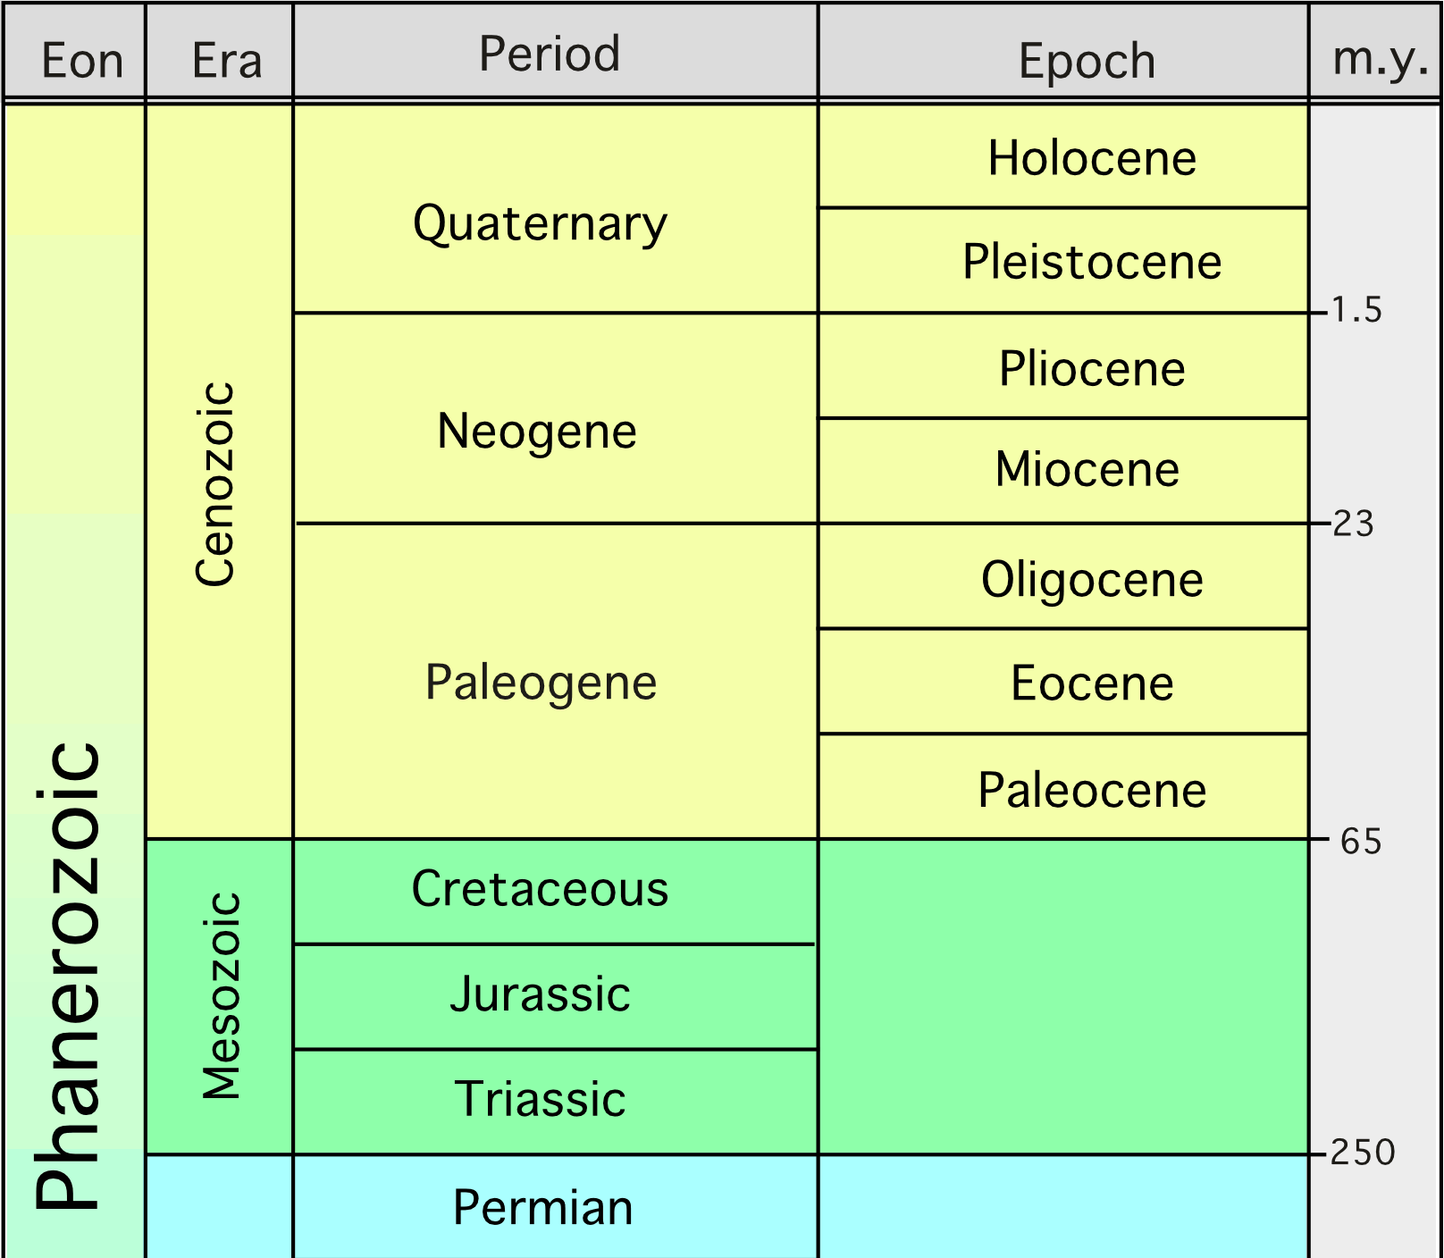
Calm
Notes:
Although the Laramide orogeny continued to affect many areas well into the Eocene, the Grand Canyon region took a well deserved rest from orogeny and erosion during the Eocene as tectonic stress transitioned from compression to extension. By this time most of the Mesozoic strata had been denuded from the Grand Canyon area, but serious canyon carving had not yet commenced.

Slide 16
Extension
Notes:
To create the gravitational potential energy necessary to carve the Grand Canyon, uplift of the Colorado Plateau and lowering of the Basin and Range are required. Both of these events are related to the shift to extensional tectonics at the time. In previous lessons we explained how extension formed the Basin and Range province. But how did extension uplift the Colorado Plateau?

Slide 17
Ice
Water
Notes:
There are various explanations, but here’s one I like because you can actually try this at home. Float a block of ice in your kitchen sink to represent the Colorado Plateau floating on the mantle.

Slide 18
Ice
compression
Water
Notes:
Now press the block of ice against the edge of the sink to represent Laramide compression.

Slide 19
compression
Ice
Water
Notes:
Laramide compression would have actually thickened the crust a bit, uplifting the crust’s surface while depressing it’s base into the mantle. Unless you’re a steroid-munching homunculus you won’t be able to do the same to your block of ice, but not to worry, you will still be able to get your plateau to uplift without thickening your ice.

Slide 20
compression
Ice
Water
Notes:
Now while still applying “Laramide” compression, melt off the top of the ice (use a blow torch, pour hot water on it or whatever) to represent erosion of the Mesozoic section. At this point the upward buoyant force of the ice below the water is greater than the weight of the ice above the water, but the ice block will not move as long as you hold it against the side.

Slide 21
Ice
extension
Water
Notes:
If you take your hand away to represent extension… Presto! Your ice plateau will float up! Now remember the real thing had added buoyant force from thickening at the base of the crust, and thus uplifted even more so than your erosion-only model.

Slide 22
Extension
Notes:
By the end of the Miocene the Colorado Plateau had uplifted thousands of feet and rotated somewhat clockwise in response to shear stress associated with the northwest motion of the Pacific Plate.

Slide 23
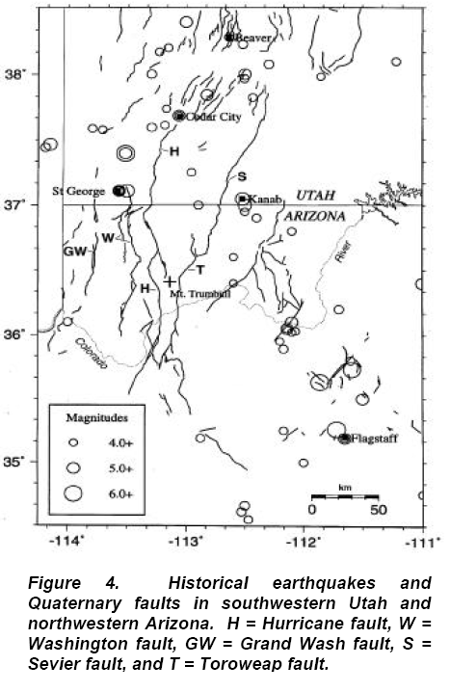
Hurricane Fault
Toroweap Fault
Major Grand Canyon Normal Faults
Notes:
Like the nearby Basin and Range, Late Cenozoic uplift of the Colorado Plateau occurred along normal faults. But unlike the Basin and Range where normal faulting occurs throughout the province, major normal faults in the Colorado Plateau are confined to its margins. One of these, the Hurricane Fault, is especially important. It is more than 125 miles long and extends from south of the Grand Canyon all the way to Cedar City Utah near Zion National Park. Indeed, normal displacement on the Hurricane Fault is a significant factor in providing the elevation difference that encouraged the erosion of both the Grand Canyon and Zion Canyon.

Slide 24
~ 7 million years ago
Notes:
Normal faulting and canyon carving where joined by another Basin and Range phenomenon - …

Slide 25
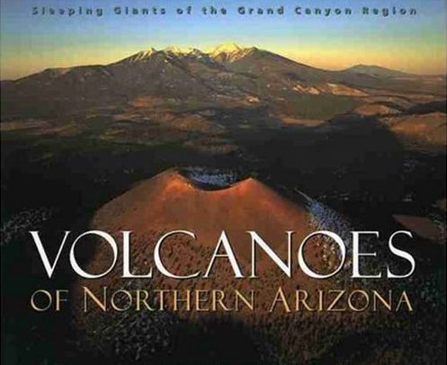
Notes:
…bimodal volcanism. But unlike the Basin and Range, bimodal volcanism in the Colorado Plateau favored basalt far more than it did rhyolite.

Slide 26
Normal fault conduit
Lava falls
Notes:
Magma made its way to the surface along conduits made by the normal faults. Since volcanism and canyon cutting happened at the same time, basaltic lava erupted from volcanoes on the plateau often spilled into the canyon producing spectacular lava falls.

Slide 27
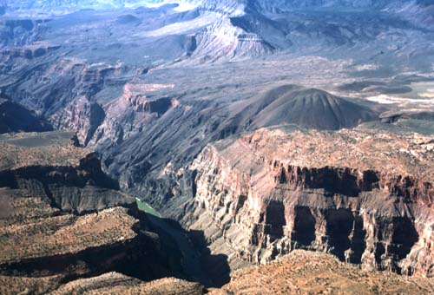
Vulcan’s Throne
Notes:
Formed only 10,000 years ago, Vulcan’s Throne, is an extremely well preserved example of one these volcanoes. The magma here was generated in the mantle and erupted from fissures along the Toroweap Fault. The basaltic magma rose very rapidly along the fissure such that there was very little opportunity for rhyolitic magma to evolve. Furthermore, the rapid assent also rapidly decompressed the magma, so dissolved gases quickly volatilized upon reaching the surface. This caused chunks of the magma to be hurled into the air, where they solidified into cinders before hitting the ground. This kind of eruption forms a type of volcano called a cinder cone.

Slide 28
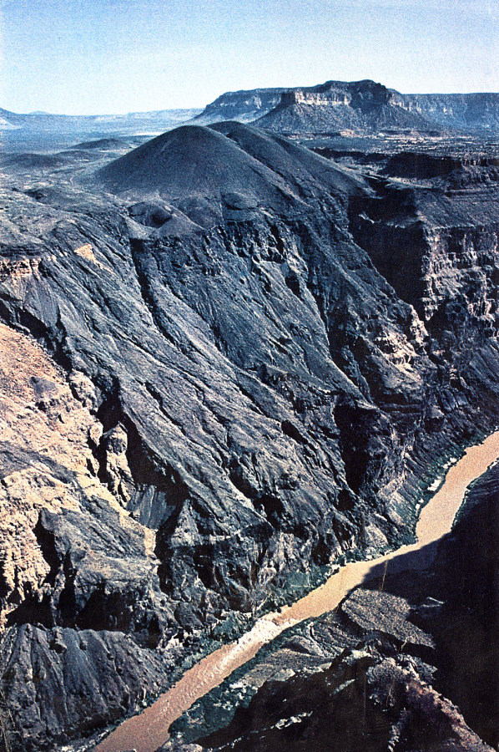
Lava Falls
Notes:
In addition to cinders, a large amount of lava erupted from these volcanoes and, in what must have been and amazing spectacle, poured some 4000 feet down the canyon’s side and into the Colorado River.

Slide 29
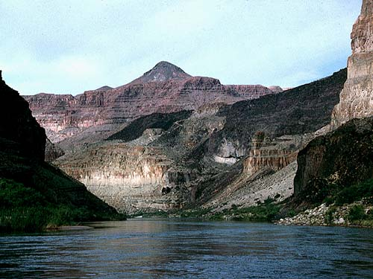
Notes:
The lava flows temporarily created a dam across the Colorado River, until the newly formed lake eventually burst through the dam.

Slide 30
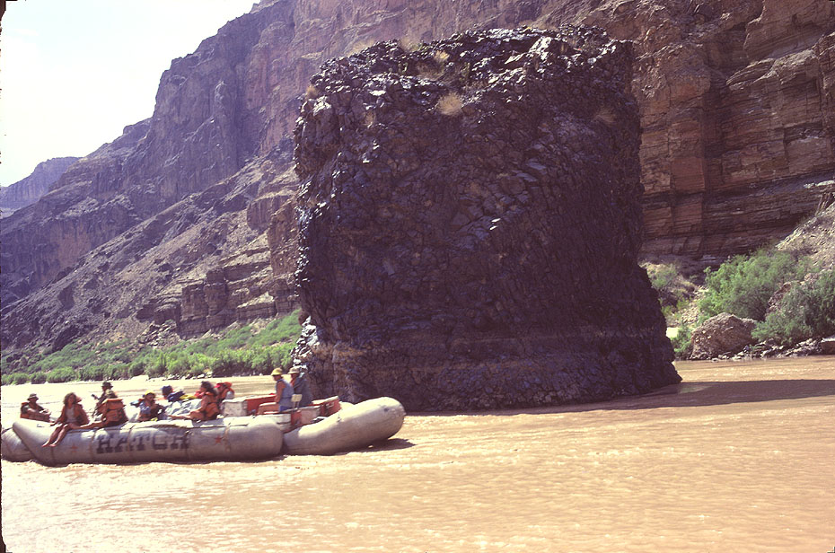
Vulcan’s Anvil
Notes:
Vulcan’s Anvil is a remnant of that dam.

Slide 31
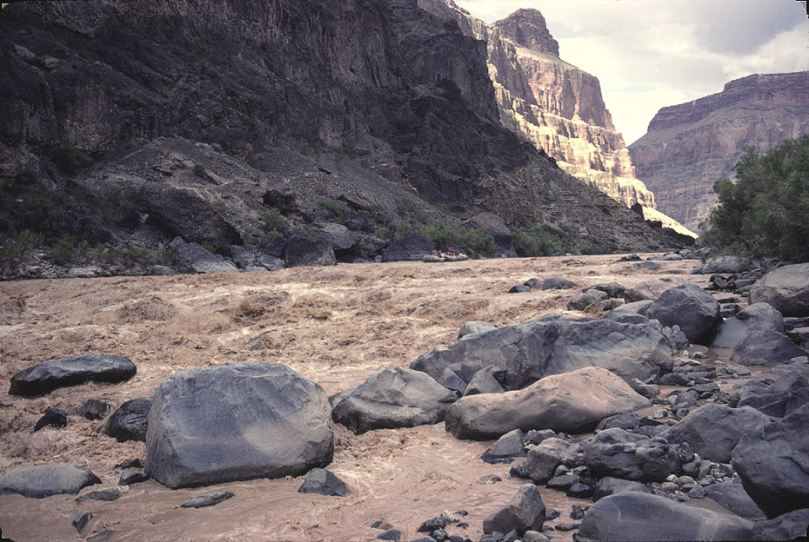
Lava Falls Rapids
Boulders from tributary
Notes:
Just downstream from the Lava Falls are Lava Falls Rapids. They are only geographically (not genetically) related to Lava Falls. These rapids, like most in the canyon, are caused by boulders emanating from side canyons.

Slide 32
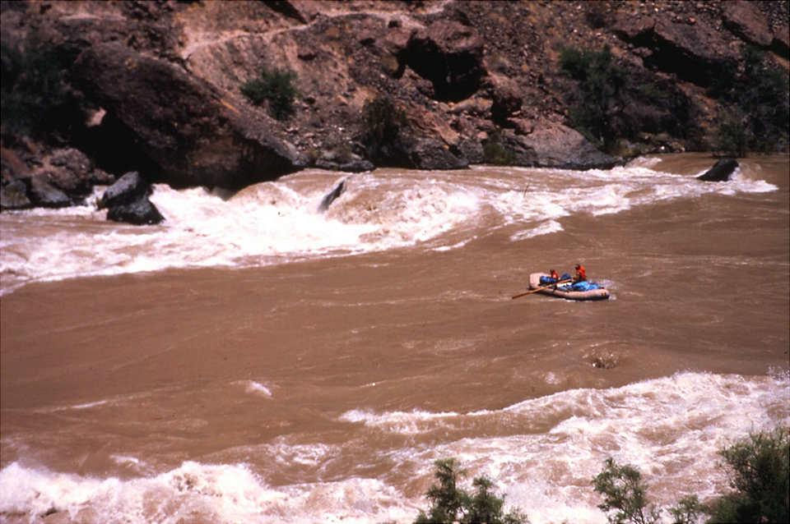
Lava Falls (El Nino, 1983)
Notes:
Although relatively short, Lava Falls Rapids is considered the most challenging in the canyon.

Slide 33
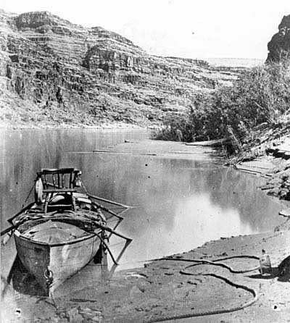
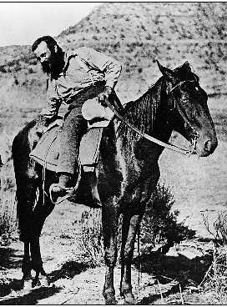
John Wesley Powell
Notes:
It’s difficult to imagine one-armed, John Wesley Powell, sitting in his early-American captain’s chair back in 1867 and leading the first expedition through the canyon via boat. There are, after all, more than 150 named rapids in the canyon! But this of course was before any dams had been built on the Colorado.

Slide 34
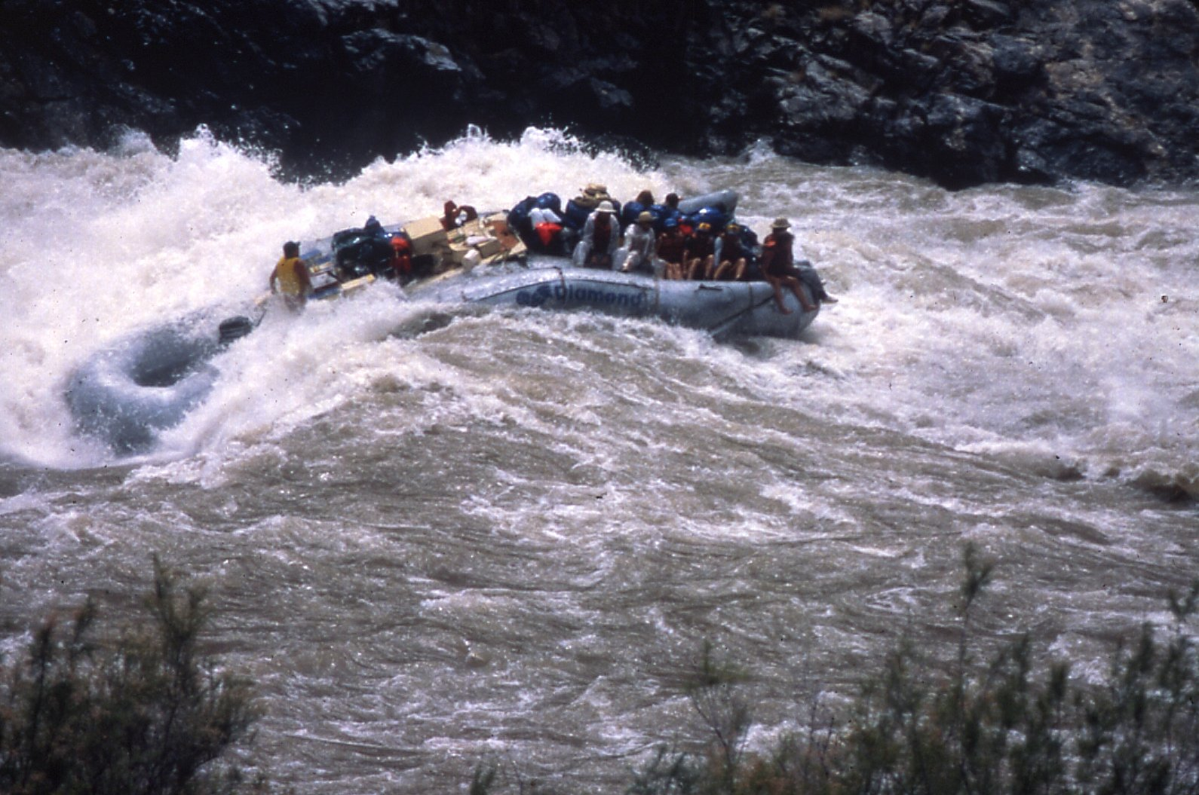
Dams make rapids bigger.
Notes:
It turns out that by trapping sediment in reservoirs, dams make rapids bigger by preventing the large boulders on the river bottom from being at least partly covered with finer sediment. In Powell’s day the bottom was probably a lot smoother and therefore rapids smaller.

Slide 35
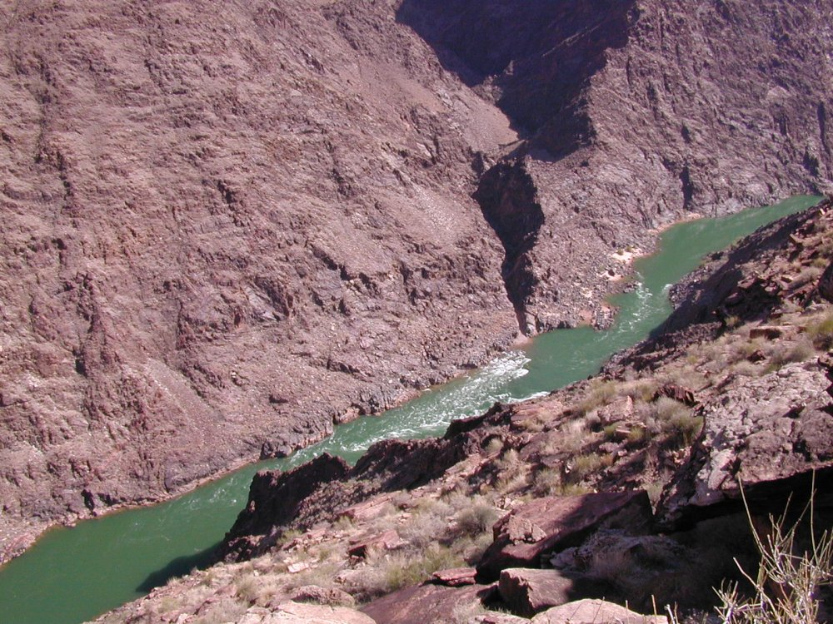
Notes:
Here’s a question for you: What does this rapid have in common with …

Slide 36
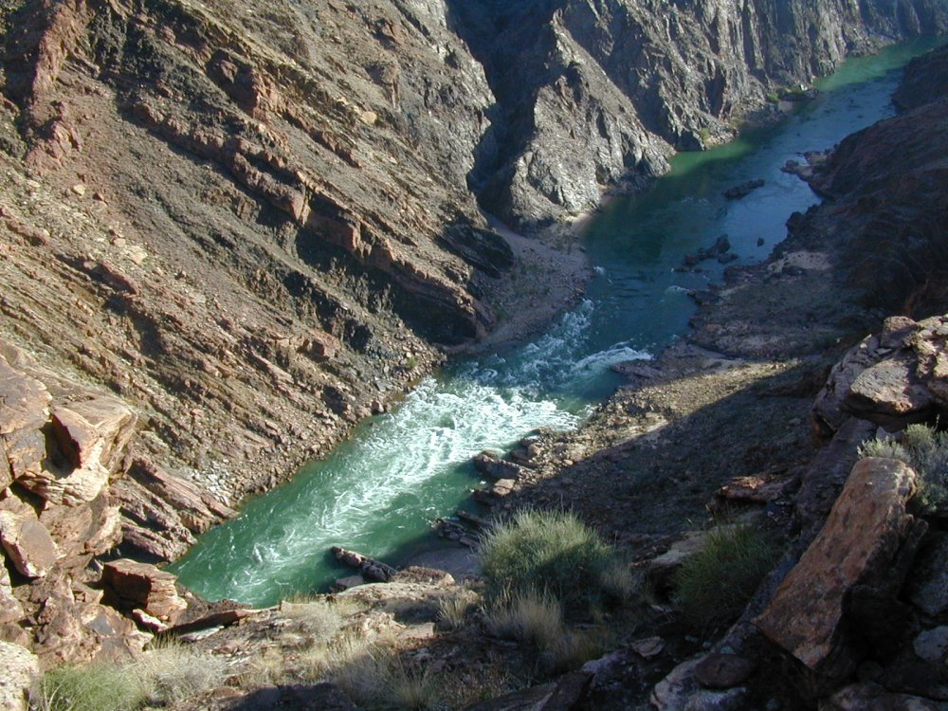
Notes:
… these rapids and ….

Slide 37
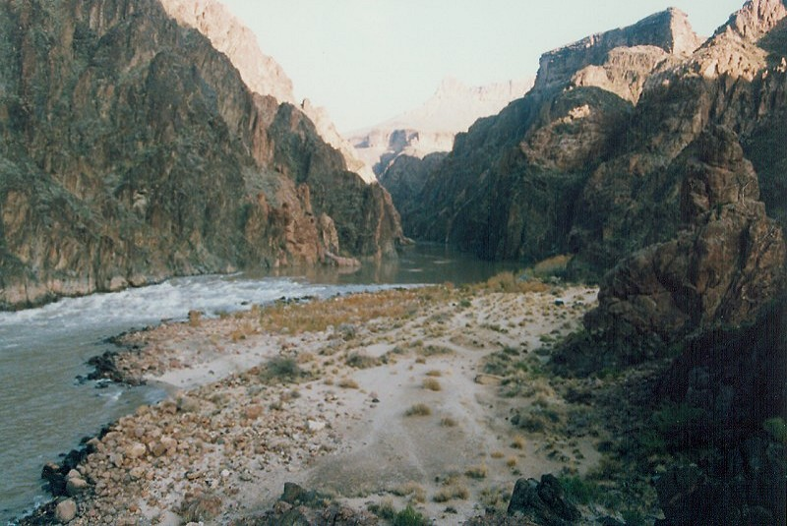
Notes:
… these rapids? Did you notice that all three occur where tributaries join the main river?

Slide 38
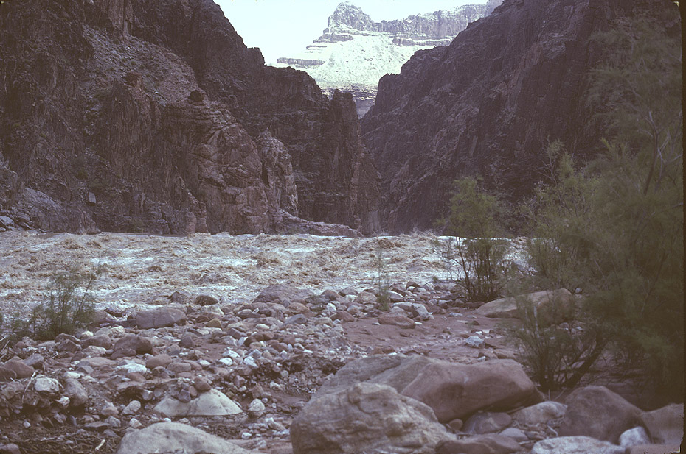
Crystal Rapids
Notes:
Crystal Rapids is one of the longest and wildest rides in the canyon, …

Slide 39
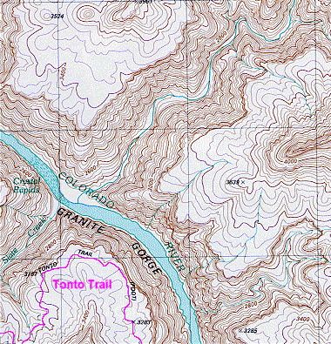
Notes:
… because it is located where two large tributaries join the canyon, so there is an especially large amount of coarse sediment added to the Colorado here.

Slide 40
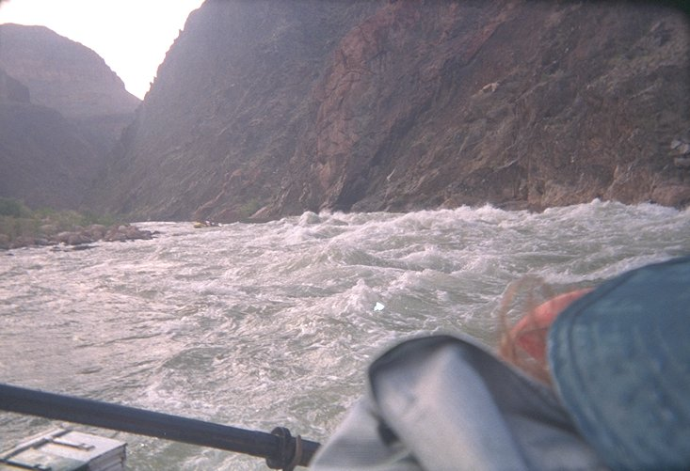
Crystal Rapids
Notes:
Looks like fun doesn’t it?!!

Slide 41
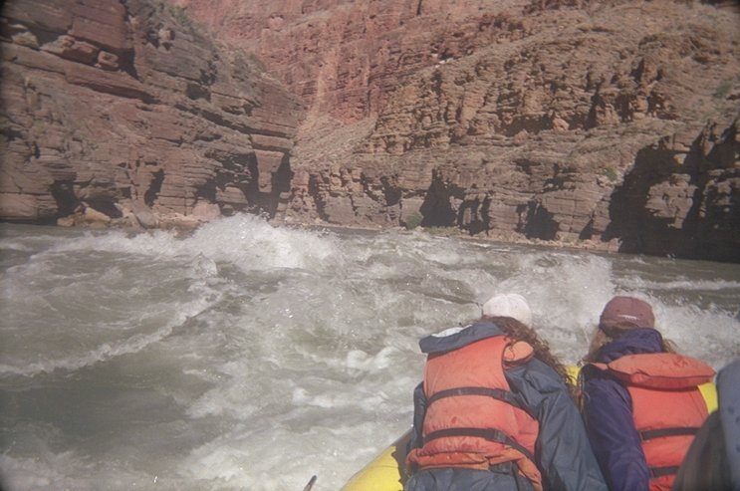
Kanab Rapids
Notes:
A Grand Canyon raft trip has to be one of the great “Bucket List” experiences. The exhilarating, instantaneous thrills of rapid running, contrasted against the deep-time awe inspired by the canyon’s geology, brings to a sharp focus, the preciousness of our tiny speck of time on this planet.

Slide 46
Notes:
Monoclines formed in the Grand Canyon area because Precambrian normal faults (remember the Proterozoic rift valleys?) were reactivated by Laramide compression and converted into reverse faults. The somewhat flexible Paleozoic and Mesozoic sedimentary rocks above these faults folded as reverse motion occurred along these faults.

Slide 52
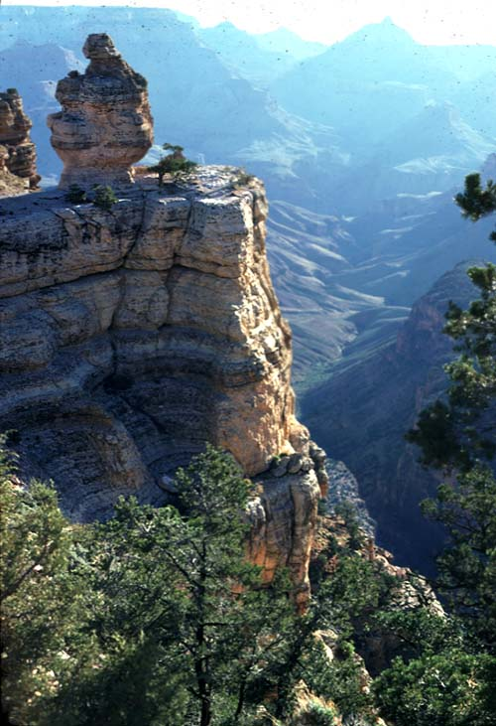
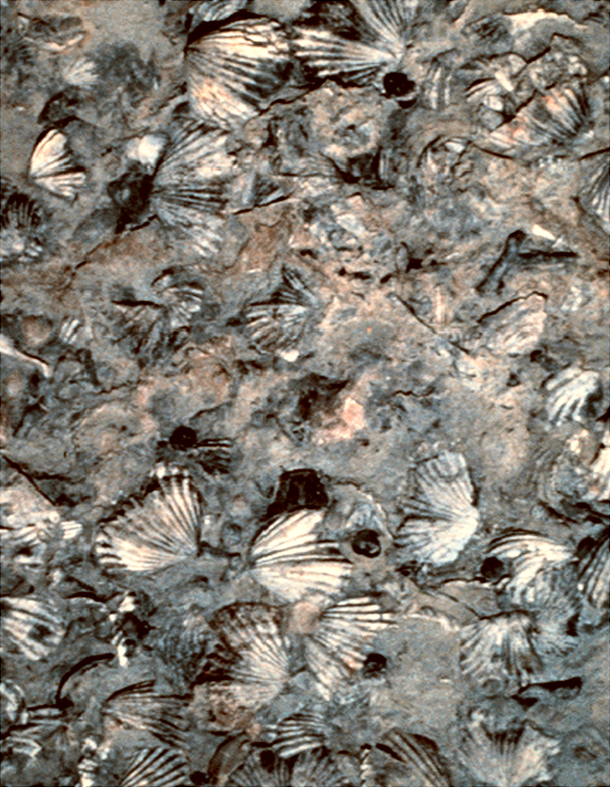
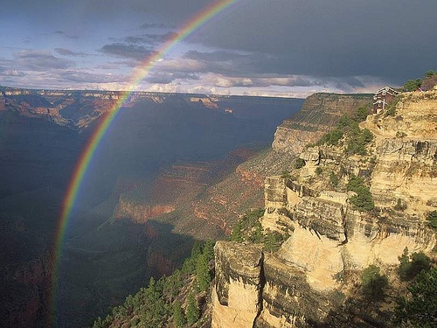
Kaibab Limestone
Notes:
Thus the Kaibab Limestone contains virtually no clastic material and is almost entirely made of skeletal remains.

Slide 56
Notes:
The Hermit Shale - 280 million years old
The Hermit Shale is the uppermost of a series of brilliant red cliffs and slopes which comprise much of the exposed depositional layers at Grand Canyon. The iron-rich red beds of the Hermit Shale provide much of the red color characteristics of Grand Canyon. In the central portion of the canyon the Hermit Shale forms a soft, deep red slope immediately below the sheer, light-colored cliff of Coconino Sandstone. It is about 300 feet thick along the Bright Angel Trail and extends to the top of the Supai Group. In places the wide slope of the Hermit Shale broadens into a shelf known as the Esplanade (primarily in the western portion of the Grand Canyon).

Slide 61
Notes:
The cave system at Vasey’s Paradise is extensive with over 2 miles of passageways.

Slide 63
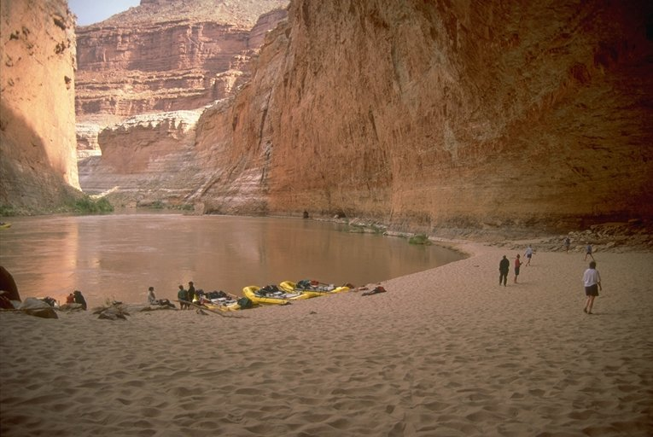
Redwall Cavern
Notes:
redwall cavern

Slide 66
Notes:
As the Cambrian ended and the Ordovician

Slide 67
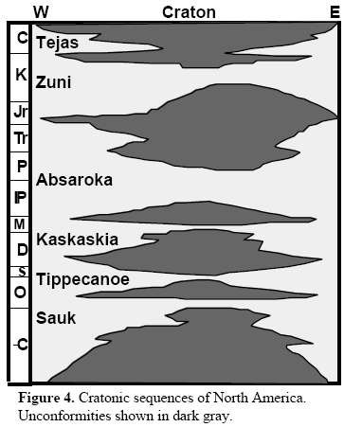
Deposition
Unconformity
(no sediment record)
Notes:
Each time the sea rose, shorelines shifted inland, towards the center of the craton and deposition (shown as white in the diagram) covered more of the craton.

Slide 68
Sediment Transfer into Oceans
(Reduces volume of ocean basins)
Notes:
If you picked sediment transfer to the oceans, then Great! You are really putting it together now.

Slide 74
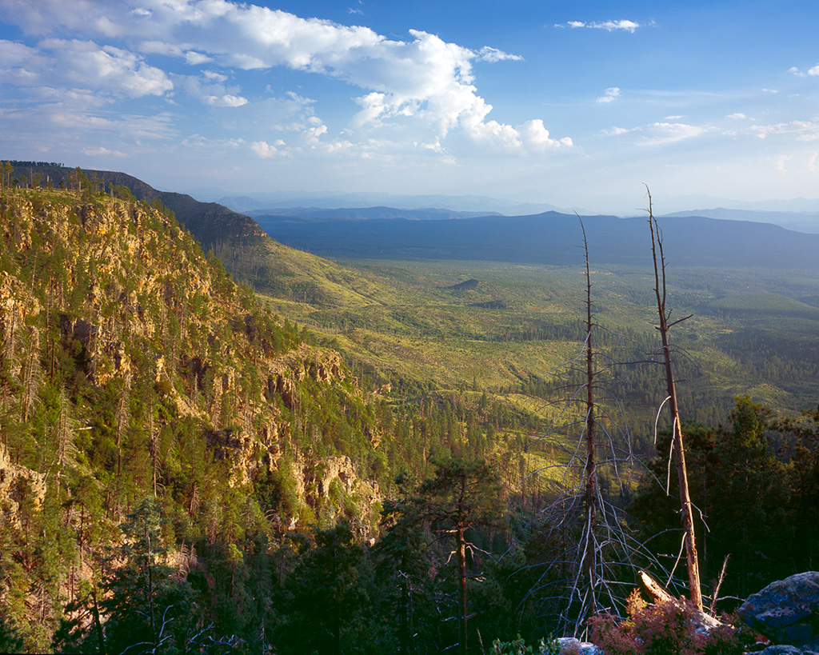
Notes:
Mogollon Rim

Slide 76
Notes:
The Grand Canyon and several other popular National Parks are located within a physiographic province, crudely centered on the four corners region, known as the Colorado Plateau.

Slide 77
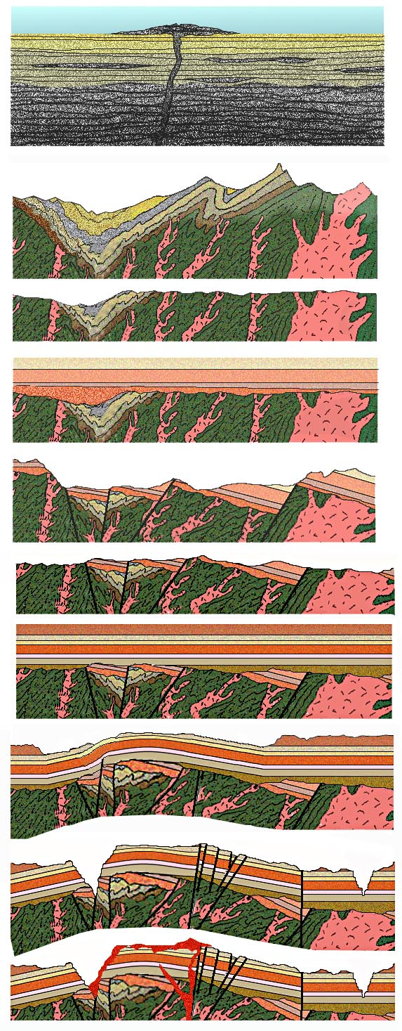

Slide 78
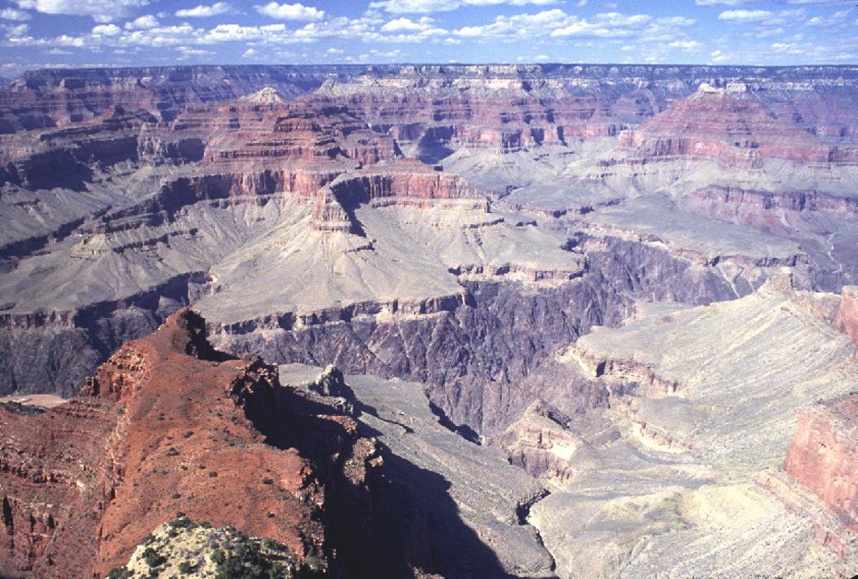
Notes:
01A DBH.jpg Inner Gorge view on South Rim

Slide 79
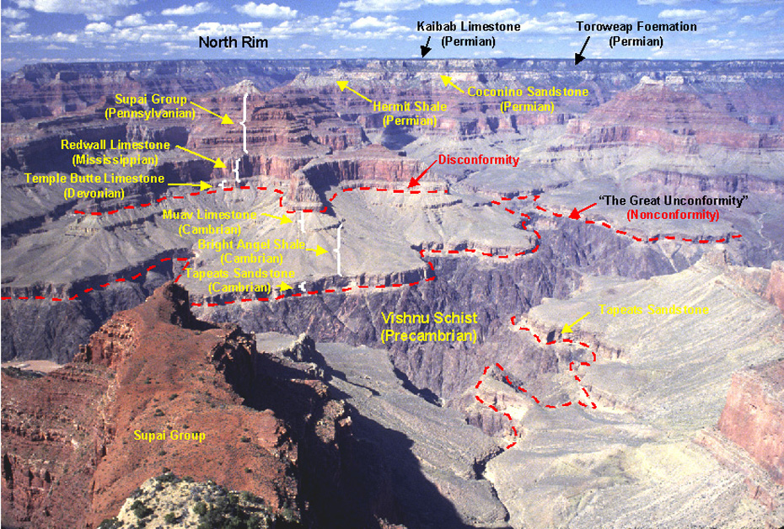
Notes:
DBH.jpg Inner Gorge view on South Rim – Annotated

